Slide 1
"Analyzing Sustainable Frameworks in the Electric Vehicle Automotive Industry"
Azhan Saleem

Slide 2
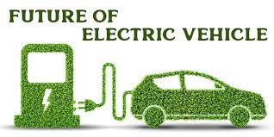

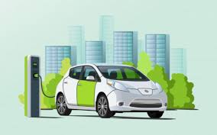
CONTENTS
Background, Introduction and Project Goal
Data
Exploratory Data Analysis (EDA)
EDA -Univariate
EDA-Bivariate
Research Questions
Modelling
Comparison of three models
Feature importance
Predictions based on best model
Insights from Eda, Modeling
Conclusions

Slide 3
baCKGROUND
Within the expanding electric vehicle market, our project addresses the critical necessity of intricate classification for Battery Electric Vehicles (BEVs) and Plug-in Hybrid Electric Vehicles (PHEVs).
This scientific precision is fundamental for stakeholders, delivering nuanced insights crucial for informed decision-making in manufacturing, policy formulation, and consumer engagement.
This endeavor propels advancements in electric vehicle research and development, contributing to the scientific evolution of sustainable transportation

Slide 4
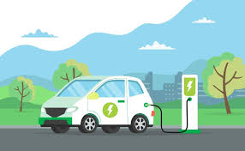
Introduction & ProJECT Goal
Revolutionizing Transportation: From Gasoline to Electric Vehicles (EVs)
Environmental Triumph: EVs offer a pragmatic solution to sustainability challenges, curbing emissions, and breaking free from fossil fuel reliance.
Washington's Eco-Friendly Surge: The state, renowned for environmental progress, experiences a noteworthy rise in EV adoption.
Data-Driven Revelations:
Thorough analysis of EV registrations.
Attributes encompass make, model, electric utility, and Clean Alternative Fuel Vehicles (CAFVs) eligibility.
Strategic Navigation:
Empowers policymakers and manufacturers with pivotal insights.
Guides strategic decisions for the evolving EV landscape in Washington state.
PROJECT GOAL
The goal of this project is to analyze electric vehicle (EV) registration data in Washington state to uncover patterns, preferences, and factors influencing EV adoption. Through this analysis, we aim to provide actionable insights for stakeholders to promote sustainable transportation.

Slide 5
DATA
Dataset source: The dataset for this project is taken from the data.gov website (https://catalog.data.gov/dataset/electric-vehicle-population-data)
VIN (1-10): The first 10 characters of the Vehicle Identification Number (VIN), which is a unique code used by the automotive industry to identify individual motor vehicles.
County: The county in Washington state where the vehicle is registered.
City: The city in Washington state where the vehicle is registered
State: The sates where the vehicle is registered. In this dataset, it should be “Washington.”
Postal Code: The postal or ZIP code corresponding to the vehicle's registration address.
Model Year: The year when the vehicle model was manufactured.
Make: The brand or manufacturer of the vehicle (e.g., Tesla, Nissan).
Model: The specific model of the vehicle (e.g., Model S, Leaf).
Electric Vehicle Type: The type of electric vehicle, which could be categories like hybrid, plug-in hybrid etc
. Clean Alternative Fuel Vehicle (CAFV) Eligibility: Indicates whether the vehicle is eligible for Clean Alternative Fuel Vehicle benefits, which might include tax incentives, rebates, or access to carpool lanes
11. Electric Range: The maximum distance the vehicle can travel on a single charge is typically measured in kilometers.
12. Base MSRP: The Manufacturer's Suggested Retail Price (MSRP) for the base model of the vehicle.
13. Legislative District: The legislative district in Washington state where the vehicle is registered.
14. DOL Vehicle ID: A unique identification number is assigned by the Department of Licensing (DOL) to registered vehicle.
15. Vehicle Location: The precise location or coordinates where the vehicle is registered.
16. Electric Utility: The electric utility company serving the area where the vehicle is registered.
17. 2020 Census Tract: A geographic region defined for the purpose of the 2020 census

Slide 6
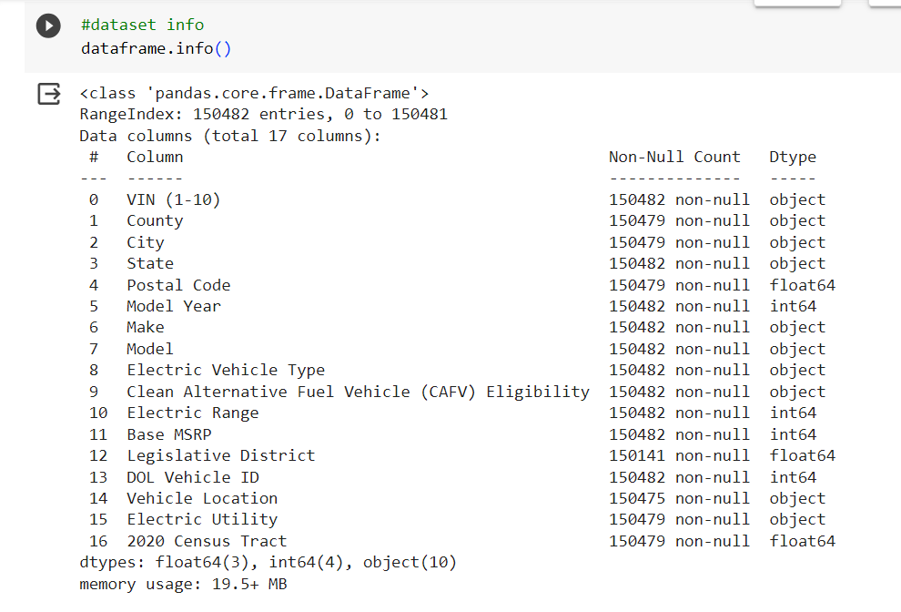
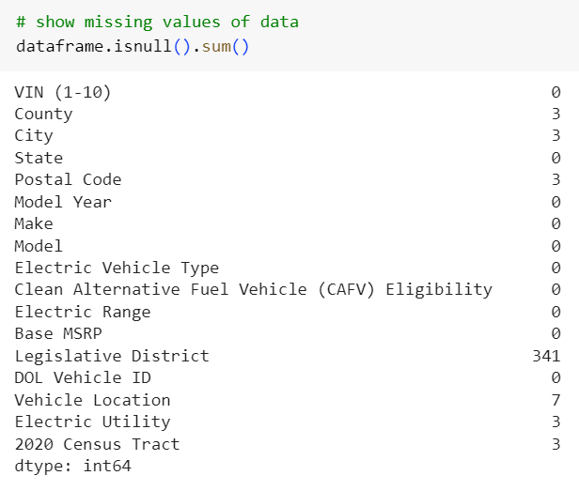
Data cleaning
dropped the missing values on the subset County and City
Missing values in specified numeric columns(Legislative District) were filled using either the median or mean method.
Missing values in designated categorical columns( Model, Vehicle Location) were replaced with the mode value for each column.

Slide 7
Feature Engineering
Electric Vehicle Type Updated: Replaced values in the 'Electric Vehicle Type' column, shortening 'Plug-in Hybrid Electric Vehicle (PHEV)' to 'PHEV' and 'Battery Electric Vehicle (BEV)' to 'BEV'.
Column Renamed: Renamed the 'Clean Alternative Fuel Vehicle (CAFV) Eligibility' column to 'Clean Alternative Fuel Vehicle Eligibility'.
Longitude and Latitude Extracted: Extracted longitude and latitude from the 'Vehicle Location' column, creating new 'Longitude' and 'Latitude' columns.
State Codes Mapped to Names: Mapped state codes in the 'State' column to their respective state names.
Substring Extraction: Extracted the first substring from the 'Electric Utility' column, enhancing data clarity.

Slide 8
Feature Engineering
For the purpose of modeling we need the categorical data in numerical format.
Ordinal Encoding Applied:
Utilized scikit-learn's OrdinalEncoder to transform 'State,' 'Make,' 'Electric Vehicle Type,' and 'Clean Alternative Fuel Vehicle Eligibility' columns into ordinal numeric values.
Converted the encoded columns to integers for consistent numerical representation.
Frequency Encoding Applied:
Leveraged the category_encoders library to perform frequency encoding on 'VIN (1-10),' 'County,' 'City,' 'Model,' and 'Electric Utility' columns.
Updated the original dataset with the frequency-encoded values for enhanced numerical representation.-
Resulting Dataset: The 'train' dataset now incorporates the applied ordinal and frequency encoding, enhancing its numerical features.
Also note that for EDA (Univariate and bivariate analysis ) the original data frame was used. Trasin dataset was used in Modeling

Slide 9
Methodology used in this Project
Data Cleaning
Data Preparation
Exploratory Data Analysis (EDA)
Model prediction

Slide 10
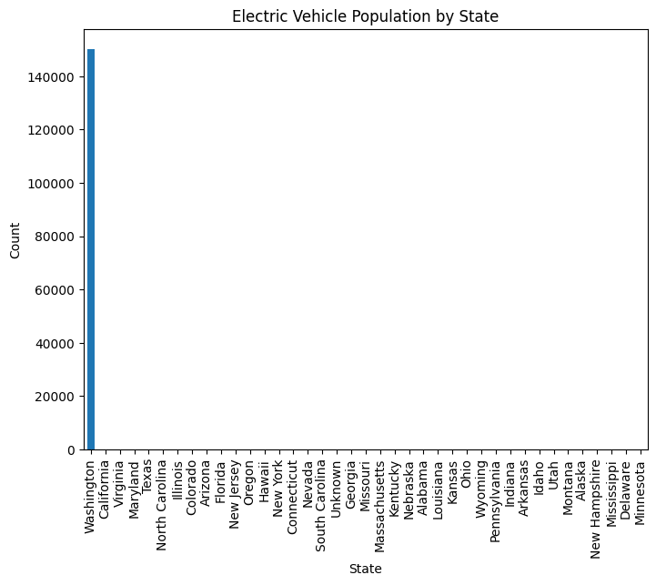
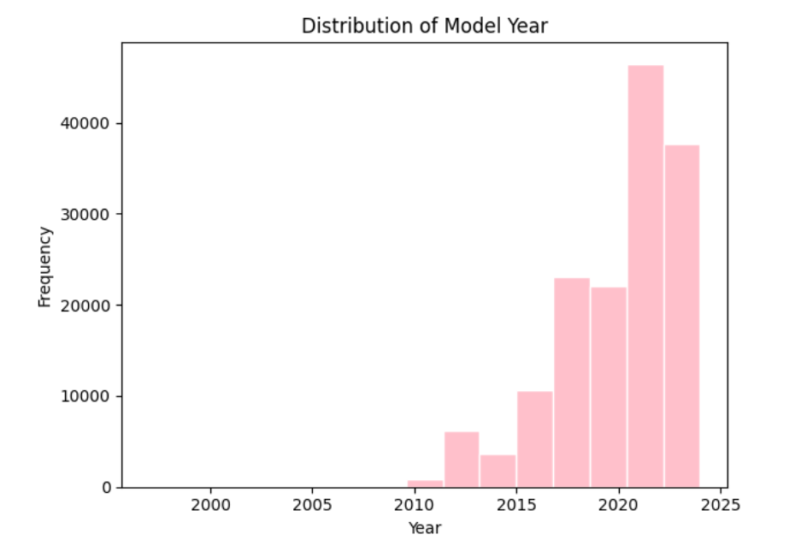
EDA -Univariate
The electric vehicle population by state vs count chart shows that Washington has the maximum count of the Elenctic vehicles.
The distribution of the car vs follows exponential growth. There ahs ben slight decline recently.

Slide 11
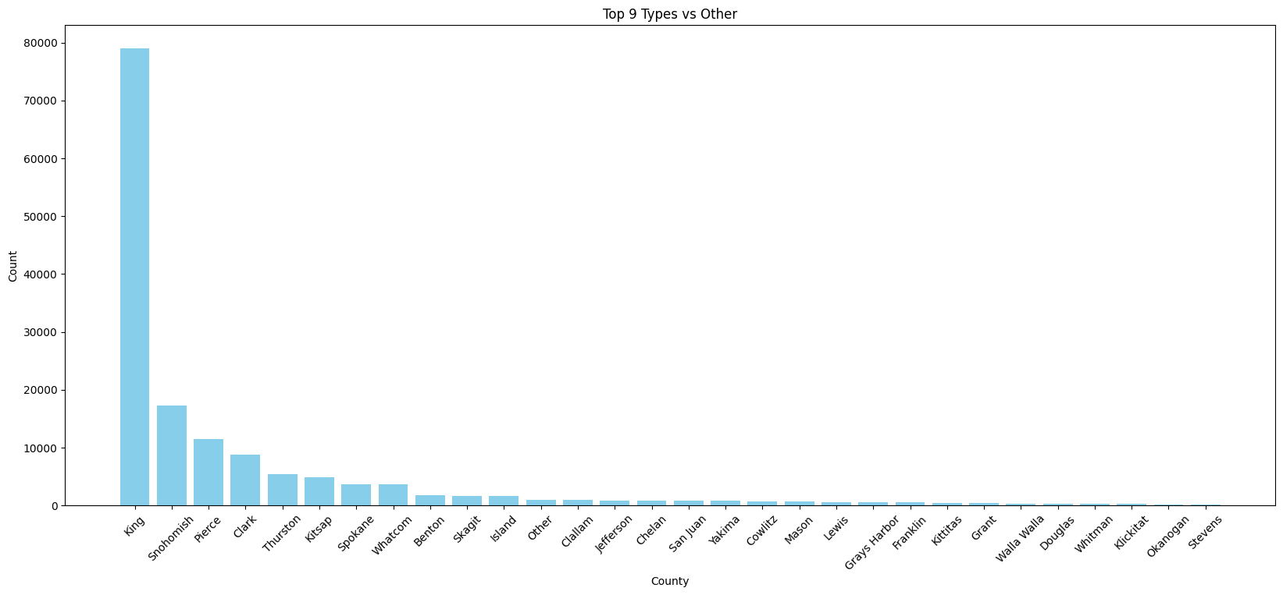
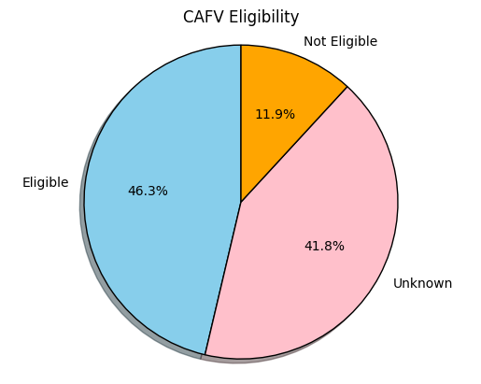
EDA -Univariate
Top county vs frequency chart. King(79075),Snohomish (17307), Pierce(11542), Clark(8855), Thurston(5403) , Kitsap(4923
Clean air fuel eligibility is approximately 47%.

Slide 12
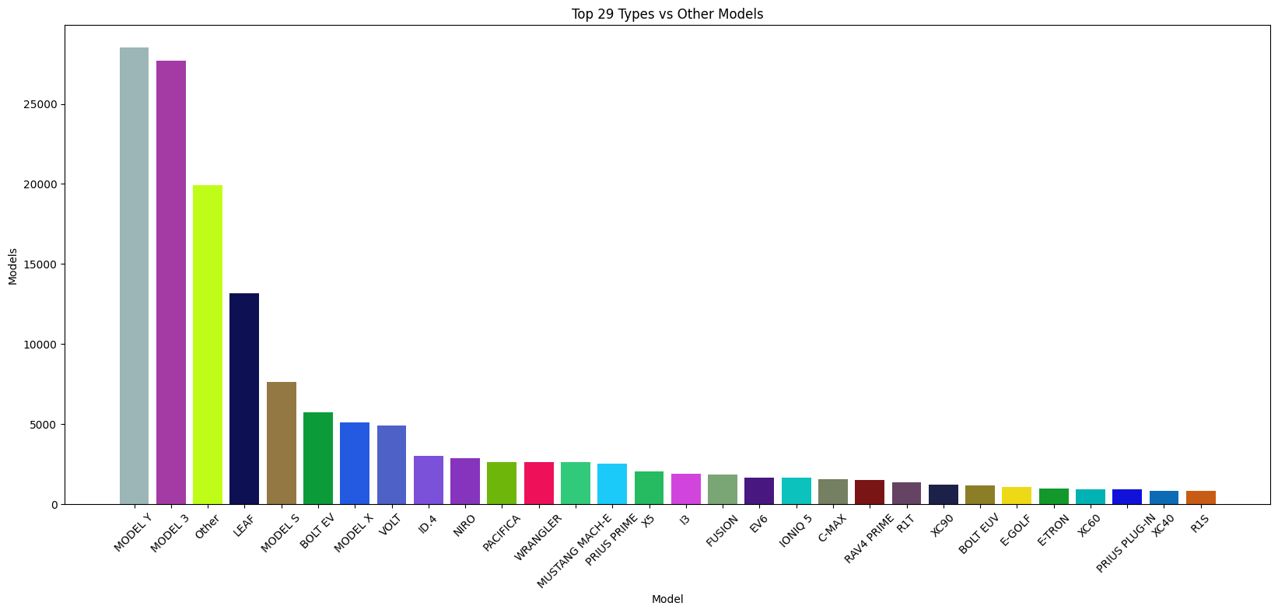
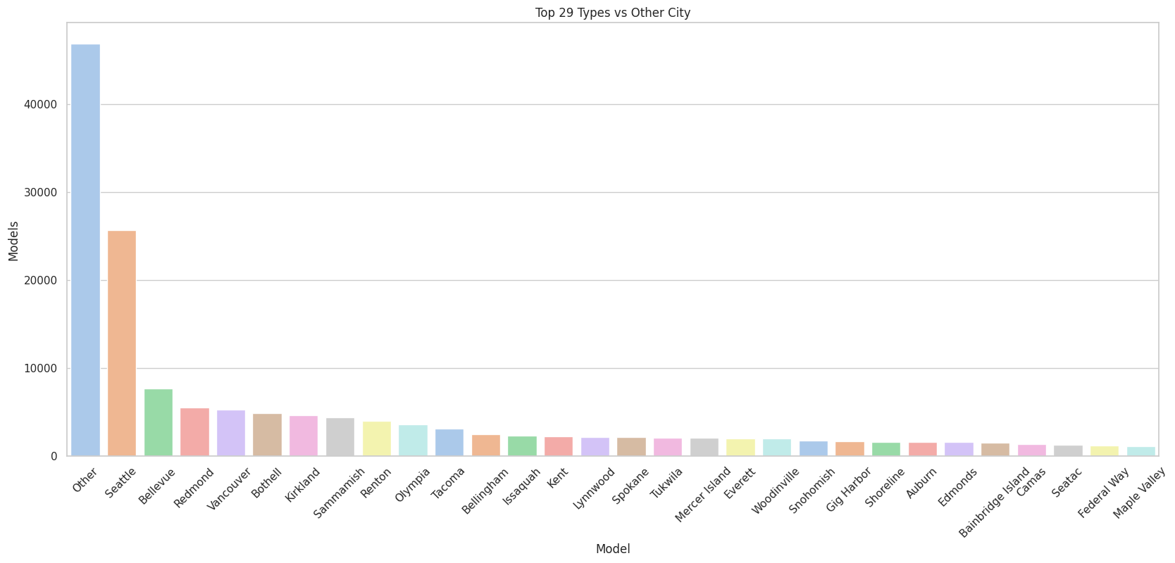
Model vs Model count graph. We note that the Model Y and model 4 are most popular.
Model vs models : Tesla is the most popular model followed by Nissan, Chevrolet.

Slide 13
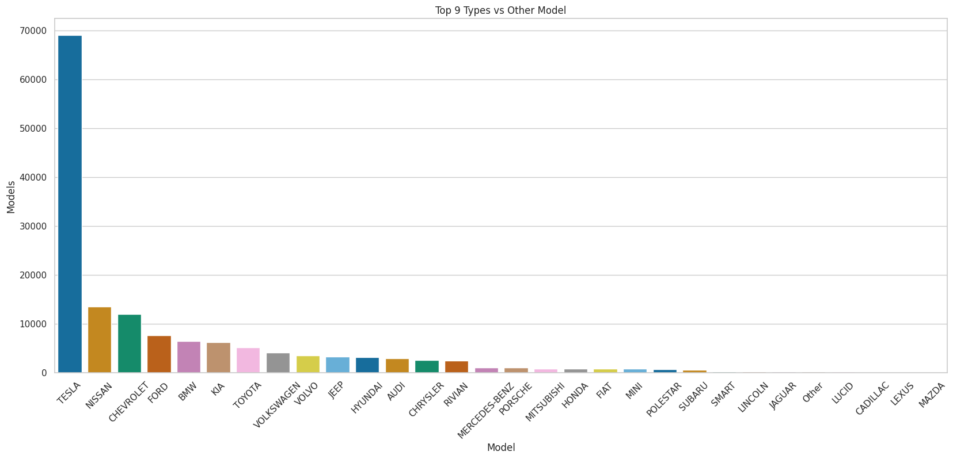
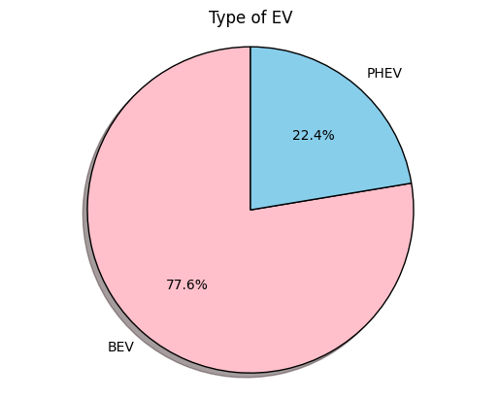
Models vs model count chart is shown here. We note that Tesla has highest count
BEV is 77.6% and PHEV is 22.4%

Slide 14
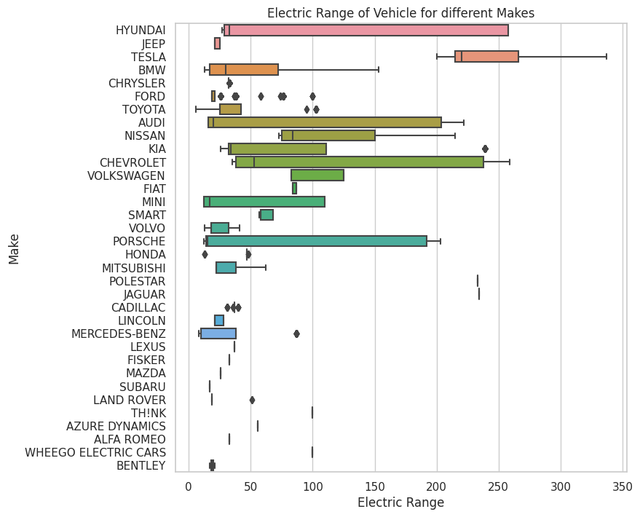
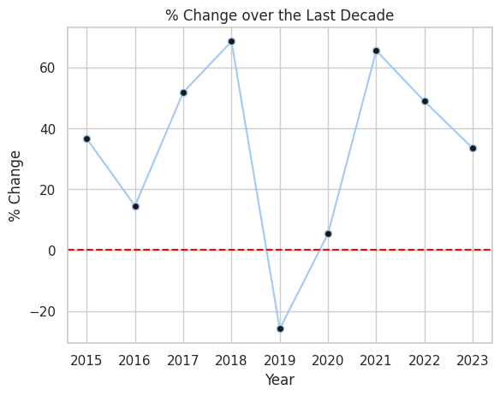
EDA-Bivariate
The percentage change over the last decade reveals a consistent upward trend, except for the sharp decline in 2019, followed by a rapid recovery. Regarding the percentage change in 2023, the trend continuing in a downward direction.
Electric range vs make of the vehicles. We note that Tesla’s electrical range is the highest

Slide 15
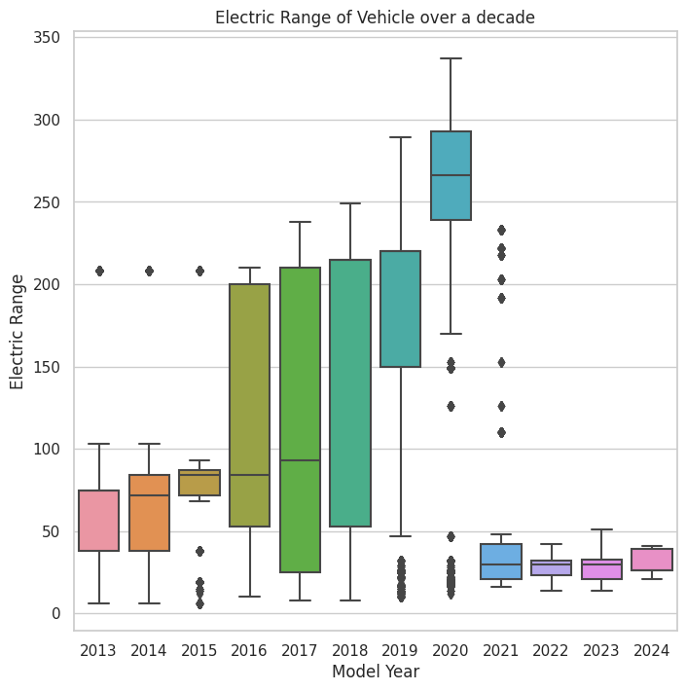
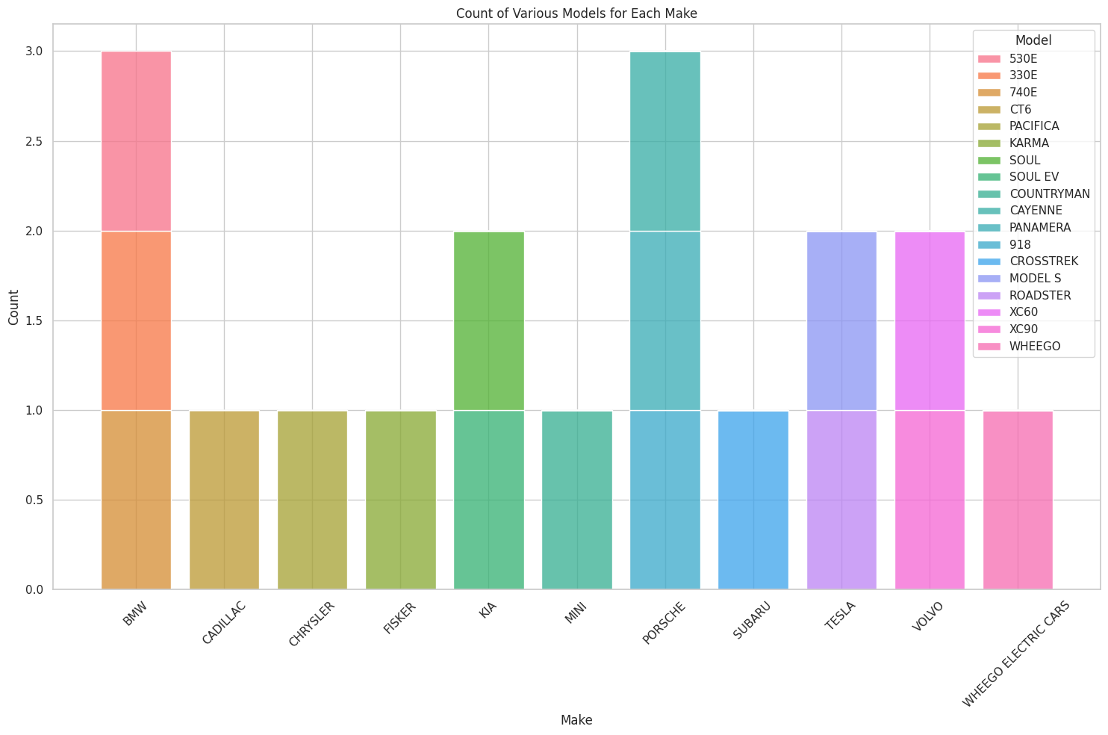
Electric range vs Model year: 2016-220 are the dominant years regarding increase in electric charge.
Count of various model of each make

Slide 16
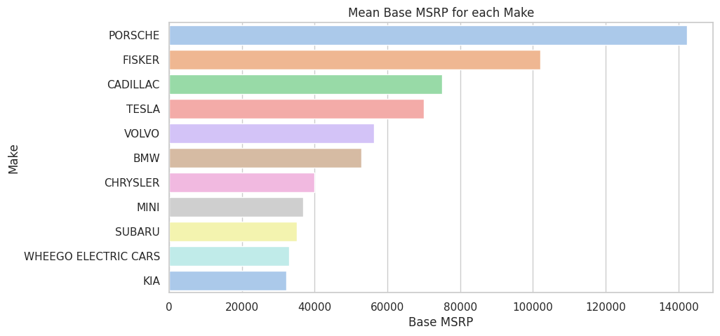
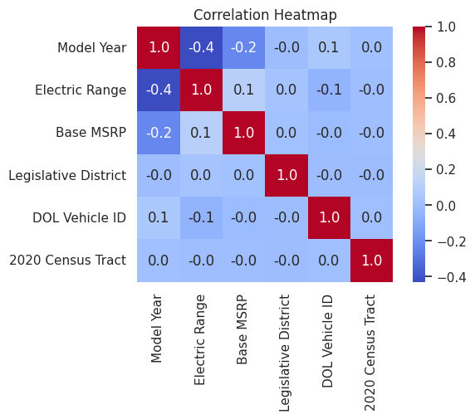
Make vs base MSRP .Porshe has highest base MSRP , followed by Fisker and Cadillac.
Correlation Heatmap of the data: The chart indicates a lack of strong linear correlations between numerous features and the target variable. This implies that the dataset predominantly comprises non-linear correlations

Slide 17
Research Questions

Slide 18
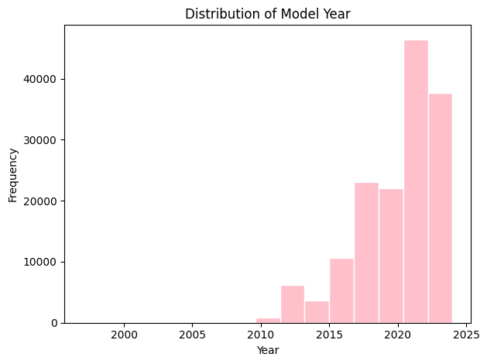
EV Adoption Over Time
Question: How has the annual adoption rate of electric vehicles in Washington state evolved over the years?
The annual adoption rate has almost followed exponential growth. There was minor dip in 2019. 2023 is till going on so cannot generalize over the last bar

Slide 19
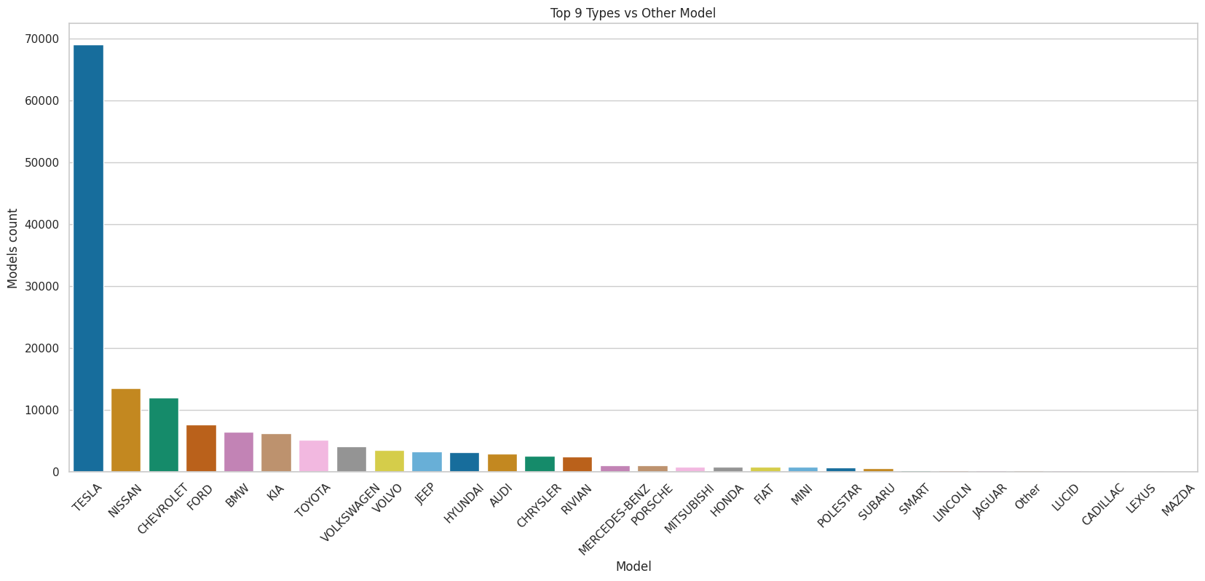
EV Type Preference
Question: Which type of electric vehicle (e.g., hybrid, full electric) is most popular in Washington state?
BEV is more popular EV with 77.6 %. Tesla followed by Nissan is the most famous electric Vehicle

Slide 20
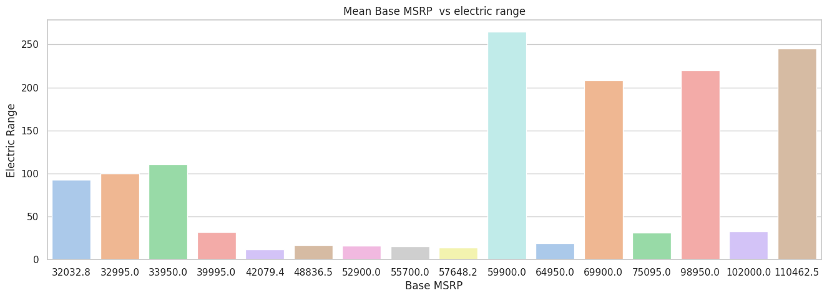
Price vs. Electric Range
Question: Is there a correlation between the base MSRP (price) of an electric vehicle and its electric range?
MSRP is highest for Prosche, Fisker and Cadillic. For higher electric range, Base MSRP us higher.

Slide 21
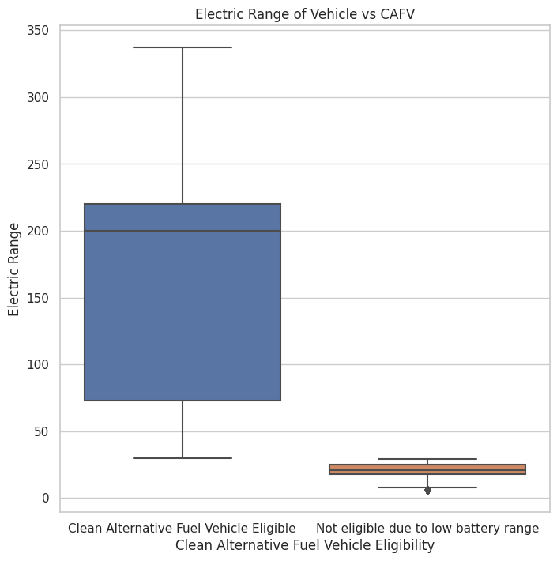
CAFV Eligibility Impact:
Question: Does the Clean Alternative Fuel Vehicle (CAFV) eligibility influence its electric range? Know CAFV eligibility is about 46.3%. CAFV is higher for higher electric range as compare to non-eligble .

Slide 22
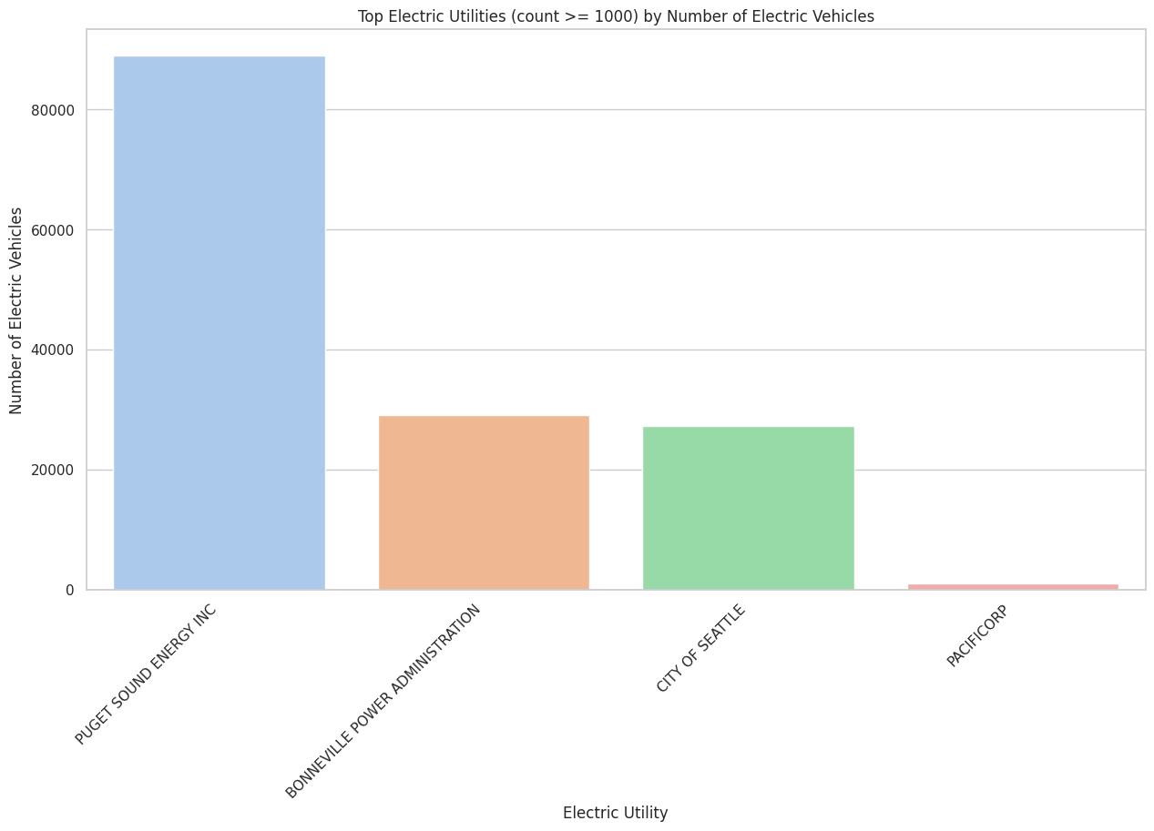
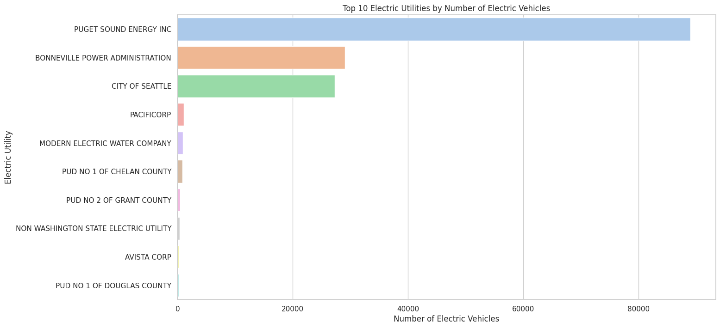
Utility Analysis:
Question: Which electric utilities support the highest number of electric vehicles? Is there a relationship between the electric utility and the type of EV adopted?
Following graph shows the top 10 electric utilities. electric utility versus number of electric vehicles. Puget sound energy inc. is the highest used utility.

Slide 23
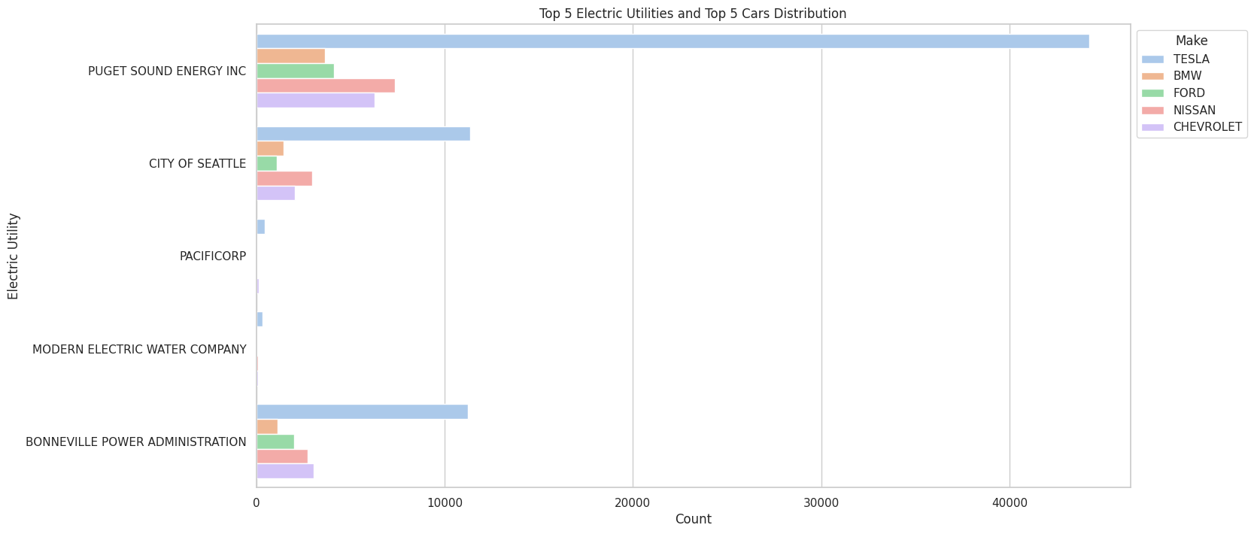
Utility Analysis:
Top 5 EV using electric utility

Slide 24
mODELING- Three models were tested
Naïve Bayes:A probabilistic algorithm, rooted in Bayes' theorem, assumes conditional independence among features. In EV data, it predicts adoption patterns based on factors like location, model, and eligibility.
Logistic Regression:A statistical method modeling the log-odds of binary outcomes using the logistic function. In EV data, it excels in binary classification, forecasting categorical outcomes such as regional EV adoption.
Random Forest:An ensemble learning technique employing multiple decision trees. In EV data, it excels in revealing intricate relationships and patterns influencing adoption, accommodating various factors and their interactions.

Slide 25
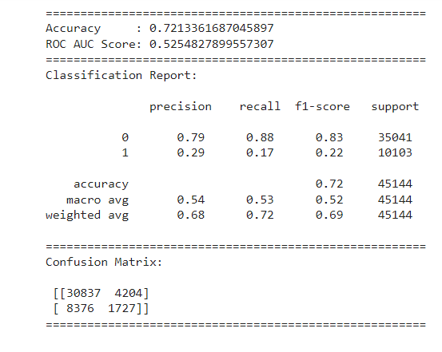
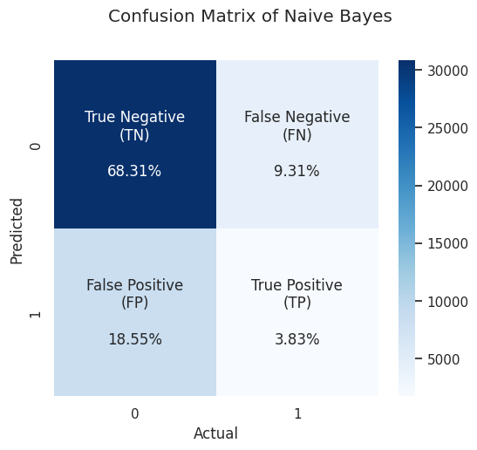
naïve Bayes

Slide 26
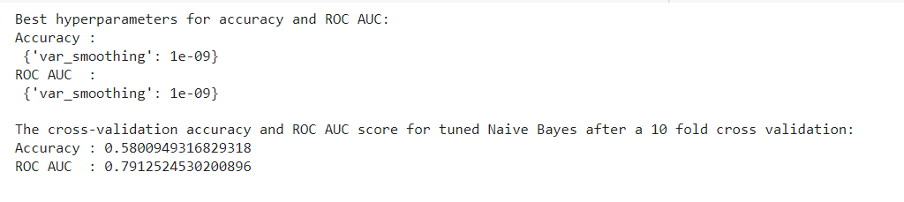
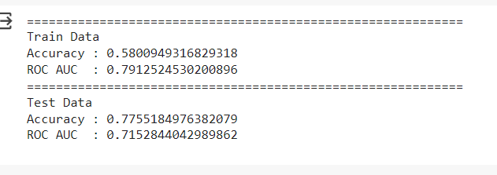
naïve Bayes : best finetuning after using hyper parameters

Slide 27
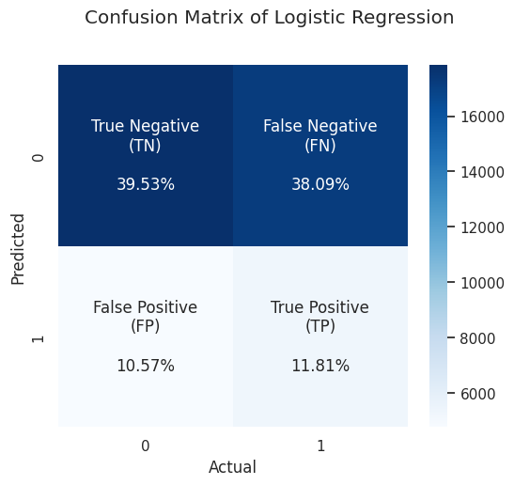
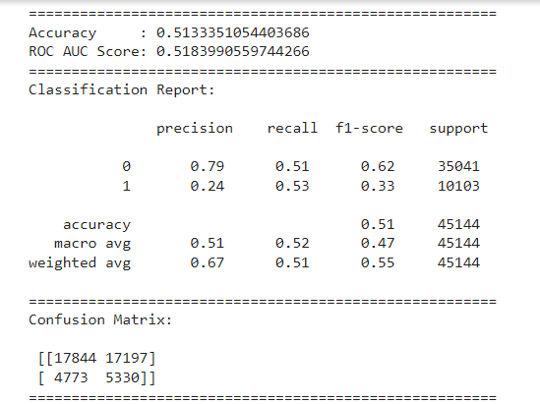
Logistic regression

Slide 28
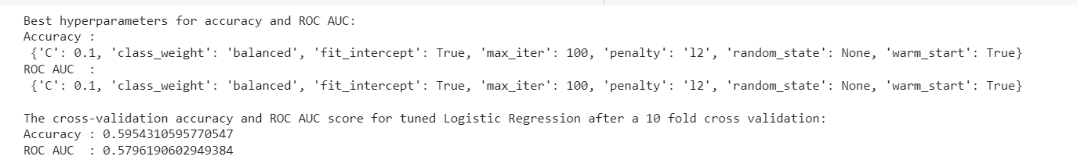
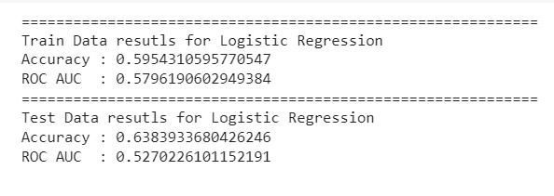
Logistic regression: best finetuning after using hyper parameters

Slide 29
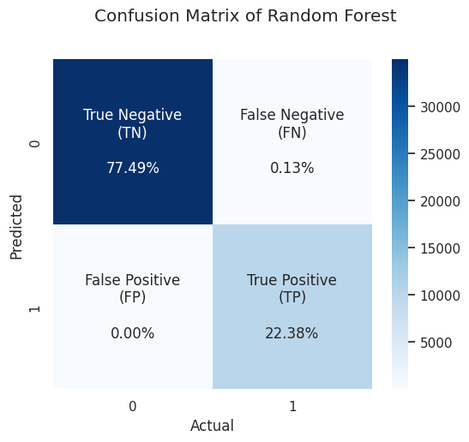
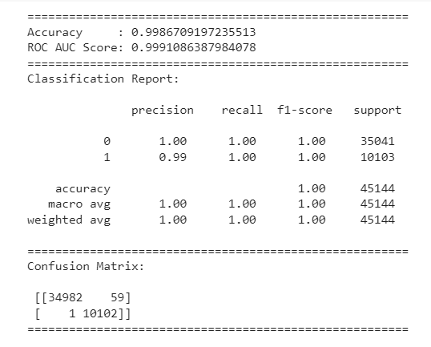
RanDom forest

Slide 30
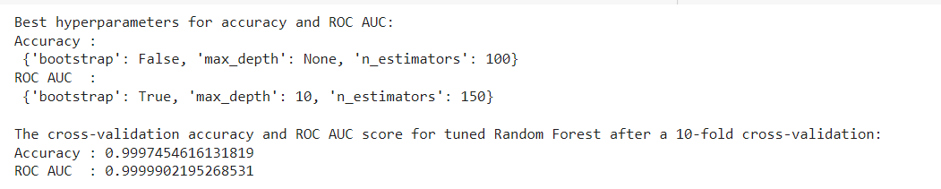
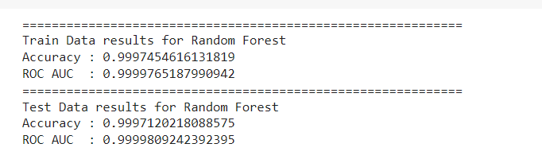
RanDom forest: best finetuning after using hyper parameters

Slide 31
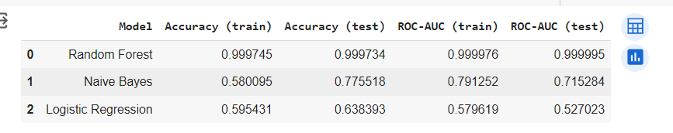
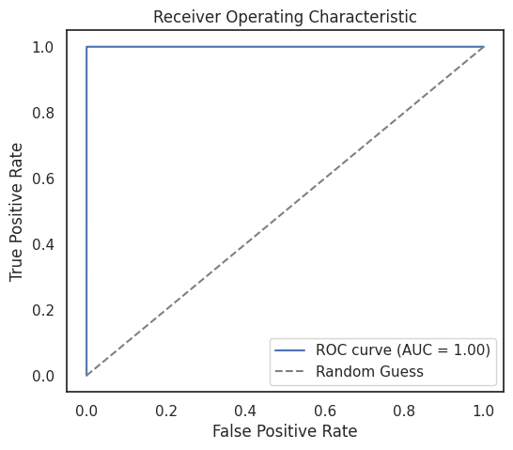
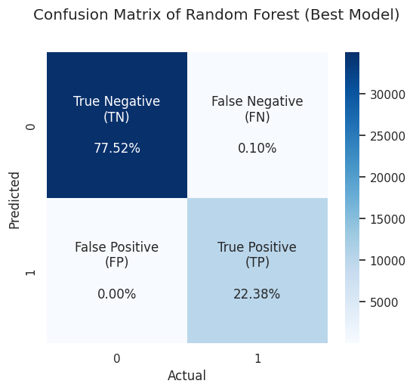
Comparison of three models

Slide 32
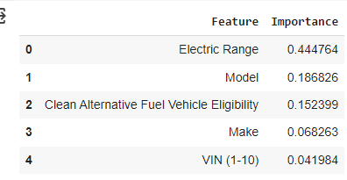
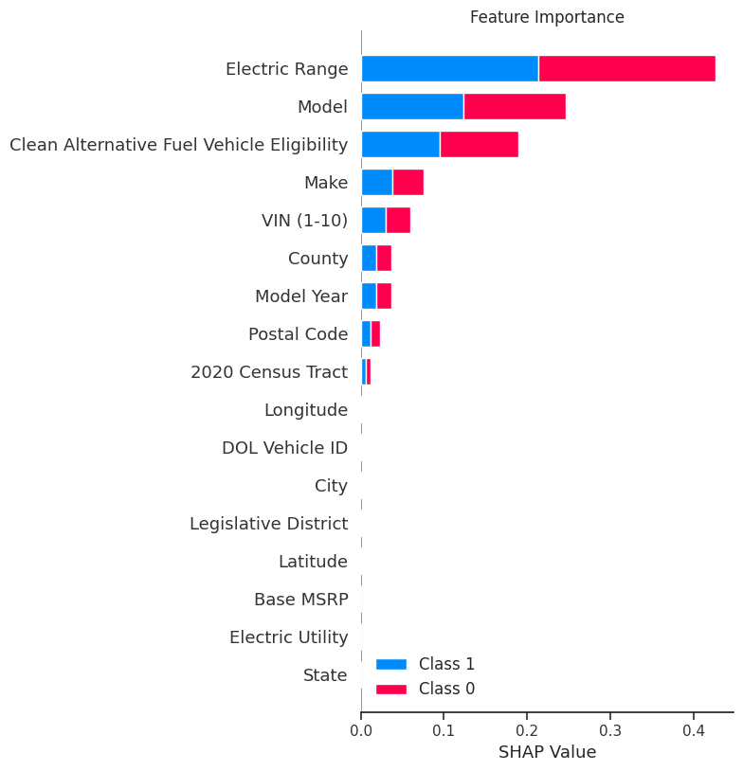
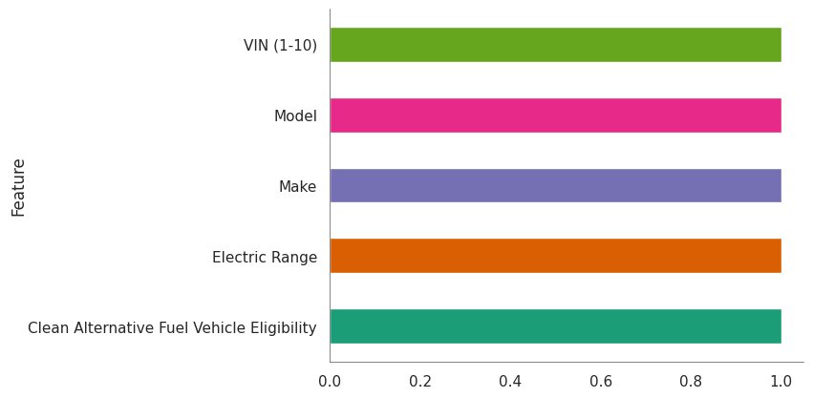
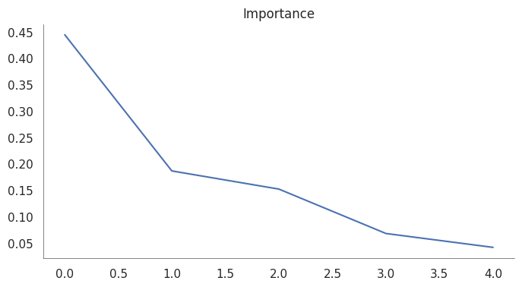
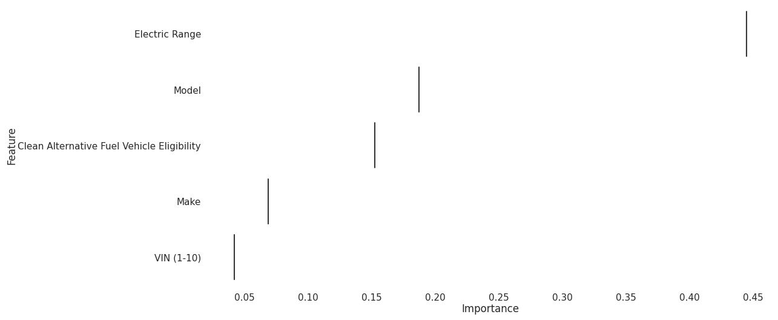
Feature importance
Top 5 important features are Electric Range, Model, CAFV, Make, Vin(1-10)

Slide 33
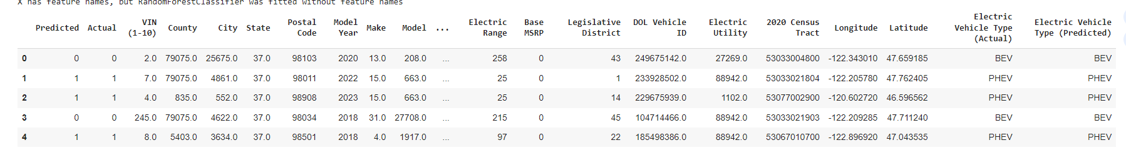
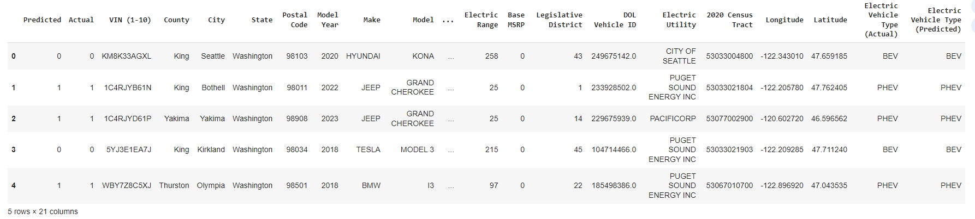
Predictions based on best model
EV type predicted by model has higher accuracy.

Slide 34
insights from EDA,modelING
Electric vehicles of the BEV (Battery Electric Vehicle) type have the largest percentage of 77.6%.
King County has the highest number of electric vehicles 79075 followed by Snohomish 17307.
Washington state is the state with the most electric vehicles
Electric vehicles made by Tesla were the highest in Washington
Electric vehicles with Puget Sound Energy electric utilities were the most common.
. Electric vehicles are most likely to meet the clean fuel (low emission) vehicle eligibility requirements.
The best model obtained is Random Forest which produces accuracy and ROC-AUC score s of 0.999745 and 0.999977, respectively
The predictions were fairly accurate.

Slide 35
Conclusions
The rise of electric vehicles (EVs) marked a transformative phase in the automotive sector, with Washington state leading the way toward sustainability.
Our in-depth analysis aimed to uncover patterns and determinants of EV adoption, providing a roadmap for stakeholders in promoting sustainable transportation.
The research addressed key questions on EV adoption rates, preferences, and economic considerations, contributing to environmental sustainability and informed decision-making.
BEV types constituted the largest percentage (77.6%) of electric vehicles, and King County led in EV numbers with 79,075, followed by Snohomish with 17,307.
Tesla dominated electric vehicle production in Washington, and Puget Sound Energy electric utilities were commonly associated with EVs meeting clean fuel eligibility.

Slide 36
tHANKS

